Slide 1
Modeling Knowledge Sharing: PART Freight Model Dashboard
Colin Smith
October 25, 2016

Slide 2
Intro and Acknowledgments
Agenda
Demonstration – a brief tour of the dashboard
Technology – a look at the technology used to build the dashboard
Next steps – new features and improvements
Acknowledgements
The dashboard was developed by Ben Chaimberg, who interned in WRJ summer 2016, and Jeff Keller

Slide 3
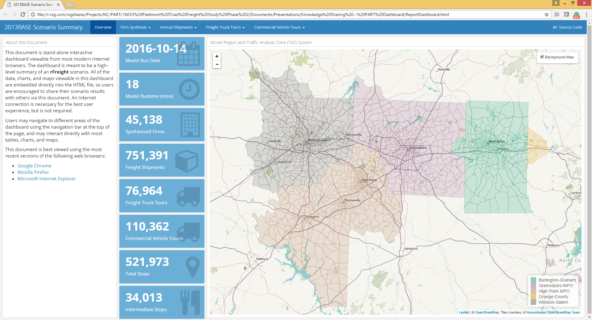
Dashboard Tour! (http://rsginc.github.io/part_model/)

Slide 4
Technology
HTML file format dashboard comprising a single HTML file.
Populated with many tables, charts, graphs, and maps
Created using R Markdown and an R package called flexdashboard
All of the interactivity is in the browser, no need for server (e.g., shiny server)
The flexdashboard package changes the format of an R Markdown file from a "document" style into a "data visualization" style
flexdashboard support objects from many R graphics packages, as well as support for the htmlwidgets package
The dashboard mainly leverages two of these libraries: plotly and leaflet

Slide 5
Workflow
Create an R markdown file (.Rmd): this mixes markdown style text and chunks of R code
When you “render” the Rmd file, the R chunks are executed and the results are “knit” together with the markdown text and formatting into a markdown file (.md). This uses the knitr package (http://yihui.name/knitr/)
The md file is then processed by pandoc (http://pandoc.org/) into the finished format.

Slide 6
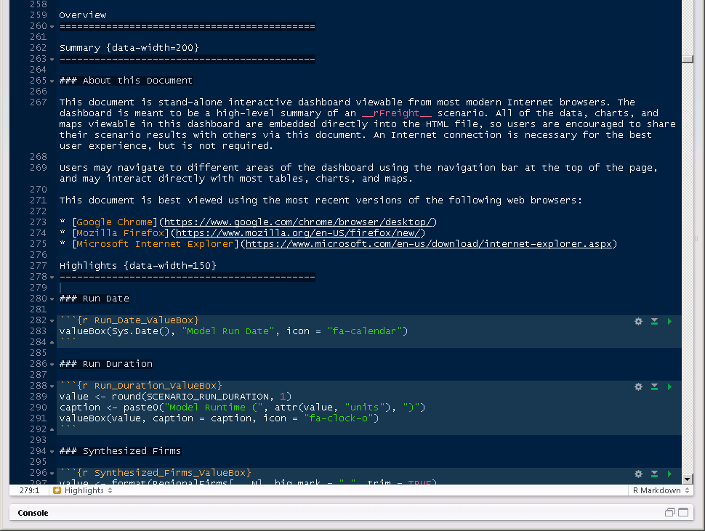
Code Structure
Uses markdown syntax to define tabs and regions within the tab
R chunks
```{r Chunk_Name}
Some r code
```

Slide 7
Code
Part_model repository on RSGInc GitHub:
https://github.com/RSGInc/part_model
https://github.com/RSGInc/part_model/blob/master/lib/scripts/Master.R - code to call scripts that builds the dashboard at end of model run
https://github.com/RSGInc/part_model/blob/master/lib/scripts/db_outputs.R -- Function to create the model region TAZ system map layer
https://github.com/RSGInc/part_model/blob/master/lib/templates/ReportDashboard.Rmd -- R markdown file that contains structural elements and R code to produce the various charts and maps
Dashboard HTML file from example run is at http://rsginc.github.io/part_model/

Slide 8
Next Steps
Refining the PART dashboard as we complete that project
Implementing in a couple of other freight projects
Additional functionality?
Different types of maps
Include network outputs – summary tables, charts, maps
Compare scenarios and present differences

